Slide 1
Branding Strategy
Unit 6

Slide 2
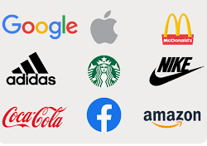
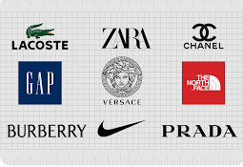
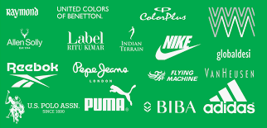
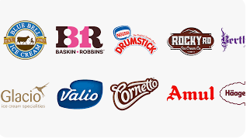
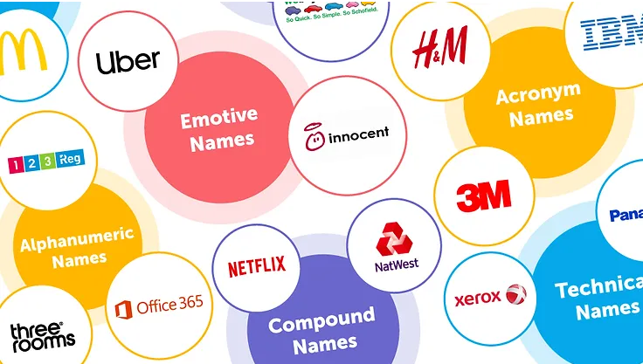

Slide 3
Concept
Branding is the process of creating a unique identity for a company, product, or service that sets it apart from competitors in the marketplace. It involves creating a visual and verbal representation of a business that communicates its values, personality, and unique selling proposition.
Effective branding can help a business build trust with customers, establish a strong reputation, and differentiate itself from competitors. It often includes elements such as a logo, tagline, color palette, and tone of voice that are consistent across all marketing and communication channels.
Branding is not just about creating a recognizable image or logo, but also about creating a connection with customers and conveying a sense of what the business stands for. However, achieving this level of branding excellence often requires the expertise. A successful branding strategy considers the target audience, market trends, and the company’s values and goals to create a memorable and impactful brand identity.

Slide 4
Definition
American Marketing Association,” A brand is a name, term, symbol or design or combination of them which is intended to identify the goods or services of one seller or group of sellers and to differentiate them from those of competitors”.
Kotler and Armstrong,” A brand is a name, term, sign, symbol or design or a combination of them, intended to identify the goods or services of one seller or group of sellers and to differentiate them from those of competitors”
Stanton, Etzel, Walker Pandit,” A brand is a name and/or a mark intended to identify the products of a one seller or a group of seller and to differentiate the produce from competing products”.
From the above definition branding is a term which is used to describe the establishment of following: Brand Name, Brand Mark, Trade Mark.

Slide 5
Brand Name
A brand name is the verbal or written part of a brand that can be spoken or written. It is essentially the name given to a product or service that differentiates it from others in the market. For instance, Coca-Cola, Maruti, Nikon, Hero etc.
“ A brand name consist of words, letters and numbers that can be vocalized”, W. J. Stanton.
“A brand name is that part of a brand which can be vocalized-the utterable”, Philip Kotler

Slide 6



Brand Mark
A brand mark is a symbol, design, color, or any visual element that identifies and distinguishes a brand without using words. It is the visual representation of ,the brand.
“A brand mark is a part of the brand that appears in the form of a symbol, design or distinctive coloring or lettering”, W.J. Stanton.
“A brand mark is that part of a brand that can be recognized but is not utterable”, Philip Kotler.

Slide 7
Trade Mark
A trademark is a legal designation that protects brand names, brand marks, and other brand elements from being used by others without permission. It provides the exclusive rights to use specific names, symbols, or designs.
“ A trademark is a brand or part that is given legal protection because it is capable of exclusive appropriation”, Philip Kotler.
“A brand that is given legal protection because under the laws it has been appropriated by one seller”, American Marketing Association.

Slide 8
Brand Name: The name or term used to identify a product or company.
Brand Mark: The visual elements (logos, symbols) associated with a brand.
Trademark: Legal protection granted to brand names, brand marks, and other brand elements to prevent unauthorized use.
Each of these elements plays a crucial role in branding, helping companies create a distinct identity and protect their brand assets.

Slide 9

Objective
Brand objectives, or branding objectives, are measurable marketing goals that employees establish for a company's brand and overall image. They refer to the actions, advertising, symbols, design, name, and wording that a company uses to distinguish its products and services from other organizations. Many organizations have brand objectives for the entire corporation and for specific lines of products and services within it. Brand objectives are important because they help employees create tangible strategies to improve the organization's brand awareness, customer engagement, organic reach, market power, and recognition. Following are the objective of branding:

Slide 10

Product Differentiation
Product Identification
To assist in Promotion
To Increase Prestige and Status
Price Stability
To Increase Brand Loyalty
Legal Protection
Consumer Welfare
Environmental protection

Slide 11
Product differentiation: Product differentiation in branding refers to the strategy of making your product or service stand out from competitors by emphasizing unique features, benefits, or qualities that appeal to your target market. To achieve successful product differentiation through branding, it's crucial to understand your target market's preferences, conduct competitive analysis, and consistently communicate the unique value proposition of your product or service.
Product identification: Product identification in branding refers to the strategies and methods used to make a product easily recognizable and distinguishable from others in the market. To achieve successful product identification through branding, it's essential to focus on consistency across all brand touchpoints, invest in distinctive and memorable design elements, and continuously reinforce the brand's unique identity in the minds of consumers.

Slide 12
To assist in promotion: Branding plays a crucial role in promotion by establishing a clear, consistent, and appealing identity that can be communicated across various marketing channels. A strong brand provides a foundation for advertising efforts. Consistent branding elements, such as logos, colors, and slogans, create a unified message across all advertising platforms, reinforcing the brand identity. Branding is fundamental to promotional efforts as it provides a clear, consistent, and appealing identity that can be leveraged across various marketing channels to achieve greater impact and effectiveness.
To increase prestige and status: Increasing prestige and status is a key objective of branding, particularly for luxury brands and premium products. This involves creating an image and perception of exclusivity, quality, and desirability. the objective of branding to increase prestige and status involves creating and maintaining an image of exclusivity, quality, and desirability. This is achieved through a combination of strategic design, targeted marketing, consistent quality, and creating an emotional connection with the target audience.

Slide 13
Price stability: Price stability is an important objective of branding, particularly for businesses seeking to maintain consistent profitability and avoid frequent price fluctuations that can confuse or alienate customers. The objective of branding to achieve price stability involves building a strong, loyal customer base, enhancing perceived value, differentiating the product, and fostering trust and consistency. These efforts help to create a market environment where stable pricing is sustainable and beneficial for both the company and its customers.
To increase brand loyalty: Increasing brand loyalty is a crucial objective of branding, aiming to cultivate a dedicated customer base that consistently prefers your brand over competitors. Brand loyalty through branding involves creating a strong and appealing brand identity, delivering consistent quality, building emotional connections, providing exceptional customer service, and continuously engaging with and understanding your customers. These efforts help create a loyal customer base that remains committed to the brand over the long term.

Slide 14
Legal protection: Legal protection is a crucial objective of branding, ensuring that a brand’s identity and intellectual property are safeguarded against misuse, infringement, and counterfeiting. This protection deters infringement, prevents counterfeiting, ensures market exclusivity, and supports the brand’s long-term value and integrity.
Consumer welfare: Branding significantly impacts consumer welfare by ensuring that consumers receive consistent quality, accurate information, and positive experiences. It aims to enhance consumer welfare by ensuring quality and consistency, providing accurate information, building trust, facilitating choice, and promoting ethical practices. These efforts collectively contribute to a positive and satisfying consumer experience.
Environmental protection: Environmental protection as an objective of branding focuses on promoting sustainability and eco-friendly practices. This objective aligns with growing consumer awareness and demand for environmentally responsible brands. Incorporating environmental protection not only helps in meeting consumer expectations and regulatory requirements but also enhances corporate reputation, reduces costs, fosters innovation, and contributes to the long-term sustainability of both the business and the environment.

Slide 15
Types
Brands come in different shapes and sizes, each with its own unique significance. Let's explore the various types of brands and what makes them special. Following are the types:
On the basis of ownership
Manufacturers brands
Middlemen's brand
On the basis of market area
National brand
regional
Provincial brand
Local brand
Product line
Family brand
Individual brand
Separate family brand
Combine brand

Slide 16
On The Basis of Ownership
Ownership types in branding can vary significantly and often influence the brand's identity and market positioning.
Manufacture's brand: A manufacturer’s brand, also known as a national brand or producer brand, is created and owned by the producer of the product or service. These brands are usually widely distributed and recognized across various retail outlets, often enjoying higher consumer trust and loyalty due to consistent quality and strong marketing efforts. For example, TATA, Sony, Apple, Samsung, PepsiCo, Johnson & Johnson etc. Manufacturer’s brands aim to build a strong, consistent brand image that resonates with consumers, leveraging their control over production and marketing to maintain a competitive edge in the marketplace.

Slide 17
Middlemen’s brand: Middlemen brands, also known as private labels or store brands, are created and owned by retailers or distributors rather than the manufacturers. These brands are typically sold exclusively through the retailer’s outlets and are often positioned as lower-cost alternatives to manufacturer’s brands. For instance, Kirkland Signature, Great Value, Market Pantry, Simple Truth etc. These middlemen brands often focus on providing value and affordability while maintaining quality, helping retailers build customer loyalty and differentiate themselves from competitors.

Slide 18
On The Basis of Market Area
National brand: A national brand is a brand that is marketed and recognized across an entire country. These brands often benefit from extensive distribution networks, robust marketing campaigns, and widespread consumer recognition. National brands can be manufacturer’s brands or middlemen brands, but what distinguishes them is their broad market reach within a nation. These national brands invest heavily in advertising and maintaining a consistent brand image to ensure they are recognized and trusted by consumers across their market area.
Regional brand: A regional brand is a brand that is marketed and recognized within a specific geographic region or area rather than nationwide. These brands often cater to local tastes, preferences, and cultural nuances, and they may not be widely available or known outside their region. Regional brands often build strong local followings by addressing the specific needs and preferences of their regional customer base, offering products that resonate with local tastes and maintaining a community-focused approach to business.

Slide 19
Provincial brand: A provincial brand is a brand that operates and is recognized within a specific province or state rather than spanning multiple regions or the entire country. These brands cater to the local population, often reflecting regional tastes, preferences, and cultural nuances. Provincial brands often emphasize local ingredients, community involvement, and products tailored to the preferences of the province’s residents. They build strong customer loyalty by focusing on the specific needs and values of their local market.
Local brand: A local brand is a brand that operates within a very specific, limited geographic area, such as a city, town, or small region. These brands often cater to the unique tastes and preferences of their immediate community and are typically well-known and trusted by residents. Local brands typically build their reputation through strong community ties, personalized customer service, and a deep understanding of local preferences. They often become integral parts of their communities and are cherished by residents.

Slide 20
On The Basis of Product Line
Family brand: A family brand, also known as an umbrella brand, is a single brand name used for multiple products within a related product line or across different product categories. The brand name is used to leverage the parent company's reputation and trust across various offerings, ensuring consistent quality and marketing efficiency. For instance, Unilever, P&G, Johnson & Johnson, Nestle etc. Family brands benefit from brand loyalty and recognition, allowing new products under the brand to gain consumer trust more quickly. They also enable cost efficiencies in marketing and brand management.
Individual brand: An individual brand, also known as a stand-alone brand, is a unique brand name used for a single product or a specific product line, distinct from the parent company's other products. This strategy allows each product to be positioned independently in the market. For instance, Maybelline: Cosmetics and beauty products, Listerine: Oral care products, Pedigree: Pet food and care products, Lay's: Snack foods, primarily potato chips etc. Individual brands allow companies to target different market segments, positioning each brand to meet specific consumer needs and preferences without affecting the overall brand image of the parent company.

Slide 21
Separate family brand: A separate family brand, or multi-brand strategy, refers to when a company uses distinct brand names for different product lines, each brand functioning independently within its specific market. This allows each product line to develop its own identity and appeal to different consumer segments. Here are some examples of companies with separate family brands based on their product lines:
Separate family brands allow companies to target different market segments more effectively, catering to diverse consumer needs and preferences without diluting the core brand identity.
Mars, Inc.
Confectionery
M&M's: Chocolate candies.
Snickers: Chocolate bars.
Pet Care
Pedigree: Dog food and care products.
Whiskas: Cat food.
Food
Uncle Ben's: Rice and grain products.
Dolmio: Pasta sauces.

Slide 22
Combined/Mixed brand: A combined or mixed brand strategy involves using both a family brand and individual brands or combining different types of branding within a product line to leverage brand equity and meet varied consumer needs. This approach can provide flexibility and cover a broader range of market segments. Here are some examples:
In a combined or mixed brand strategy, companies use their overarching family brand to build general trust and credibility, while specific brands within their product lines address targeted market needs and preferences.
Colgate-Palmolive
Family Brand: Colgate-Palmolive
Mixed Brands:
Colgate: Oral care.
Palmolive: Soaps and personal care.
Ajax: Household cleaning products.
Fabuloso: Multi-purpose cleaners.
Strategy: Colgate-Palmolive uses its corporate brand to signify quality across categories but differentiates product lines with individual brands.
PepsiCo
Family Brand: PepsiCo
Mixed Brands:
Pepsi: Soft drinks.
Lay’s: Snack foods.
Gatorade: Sports drinks.
Quaker: Oats and cereals.
Strategy: PepsiCo leverages its corporate brand while utilizing specific brands for distinct product categories to reach various consumer segments.

Slide 23
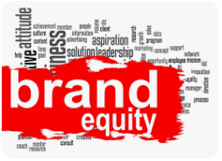
Brand Equity
Brand equity is the value premium that a company generates from a product with a recognizable name, when compared to a generic equivalent. Companies can build their brand equity with their products by making those products memorable, easily recognizable, and superior in quality and reliability. Mass marketing campaigns also help to create and strengthen brand equity.
When a company has positive brand equity, customers willingly pay a high price for its products, even though they could get the same thing from a competitor for less. Customers, in effect, pay a price premium to do business with a firm they know and admire.

Slide 24
Key Takeaways
Brand equity refers to the value a company gains from its name recognition and its perceived benefits and admirable qualities.
Brand equity has three basic components: consumer perception, negative or positive effects, and the resulting value.
It has a direct impact on sales volume and a company's profitability because consumers gravitate toward products and services with great reputations.
Often, companies in the same industry or sector compete on brand equity.

Slide 25
Definitions
Brand Equity is “a set of assets and liabilities linked to a brand, its name and symbol that adds to or subtracts from the value provided by a product or service to a firm and/or to that firm’s customers”, Aaker (1991).
“A set of assets or liabilities in the form of brand visibility, brand association and customer loyalty that add or subtract from the value of a current or potential product or service driven by the brand”, Prof. David Aacker.
“ The differential effect that brand knowledge has on consumer response to the marketing of that brand. Brand equity is influence by the brands perceive quality, brand loyalty, and brand association with together shape consumer behavior and decision making”, Philip Kotler.

Slide 26
Elements and Components
Brand equity is important for increased customer loyalty, which can translate to repeated and increasing sales despite higher-priced products or services. Brand equity is also important because it supports higher perceived value, greater customer satisfaction, and a more stable customer base. Simply put, consumers are more likely to choose a brand that they know and trust. The elements of brand equity include:
Brand awareness: The extent to which consumers are familiar with and recognize a brand.
Brand loyalty: The degree to which consumers consistently choose a specific brand over others.
Brand image: The perception of attributes that consumers have of a brand, such as quality, reliability, and uniqueness.
Brand associations: The emotional or psychological associations that consumers connect with a brand, such as feelings of trust, reliability, or nostalgia.
Brand value: The perceived benefits and overall value that consumers attribute to a brand.

Slide 27

Thank you

